Slide 1
Data Structures
Stacks and Queues

Slide 2
Stack is a linear data structure which appears as a group of elements stored at contiguous locations in memory.
Elements are added or removed only at one end, called top of the stack. There is no way to add or delete elements anywhere else in the stack.
A stack is based on Last-In-First-Out (LIFO) principle that means the data item that is inserted last into the stack is the first one to be removed from the stack.

Slide 3

Examples of stack in real life

Slide 4
Stack Operations
The most commonly implemented operations with the stack are PUSH and POP.
The PUSH operation is known as the INSERT (adding) operation and the POP operation is known as DELETE (reading) operation.
During the PUSH operation we have to check the condition for OVERFLOW and during the POP operation we have to check the condition for UNDERFLOW.

Slide 5
OVERFLOW
The situation of trying to insert an element to a full stack.
In general if one can try to insert an element to a full data structure then that will be called as OVERFLOW.
Condition for OVERFLOW
Top = size −1

Slide 6
UNDERFLOW
The situation of trying to delete an element from an empty stack.
In general if one can try to DELETE an element from an empty data
structure then that will be called as OVERFLOW.
Condition for UNDERFLOW
Top = −1

Slide 7
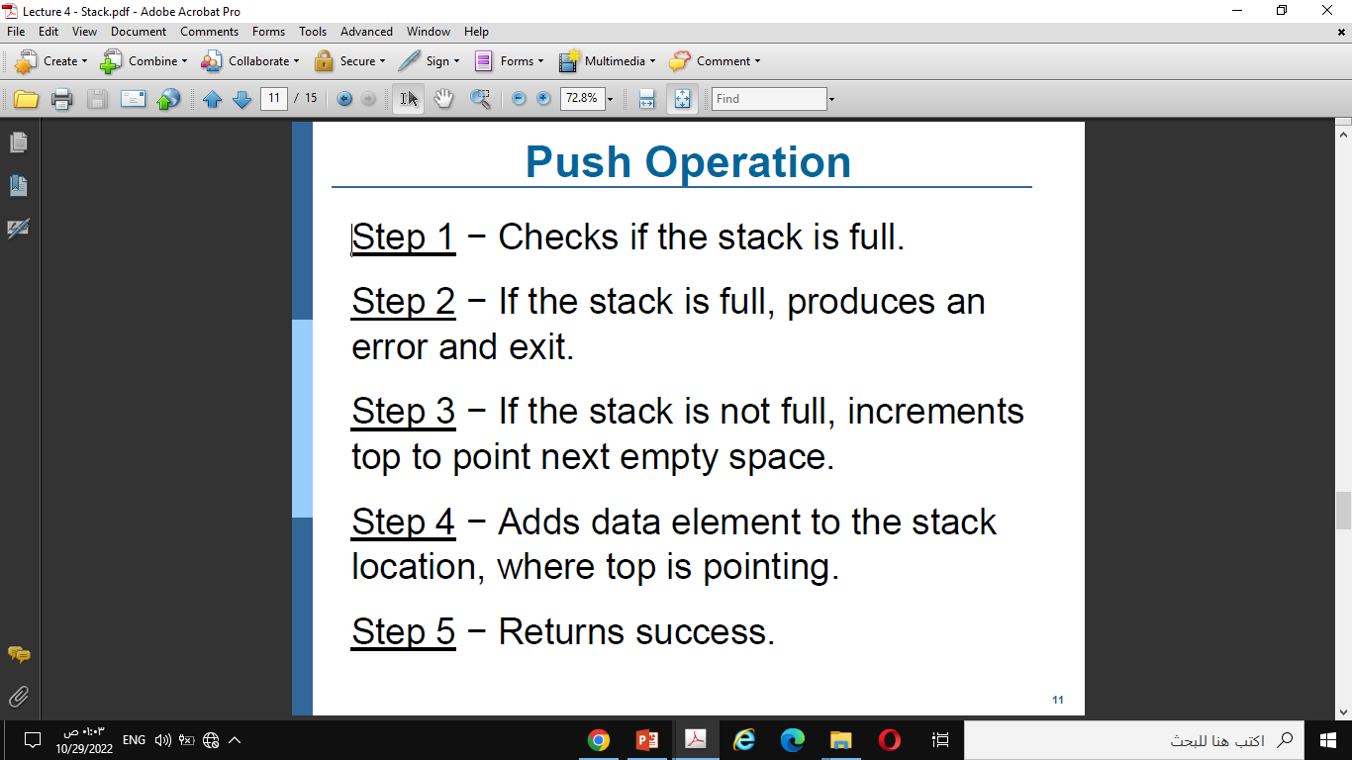
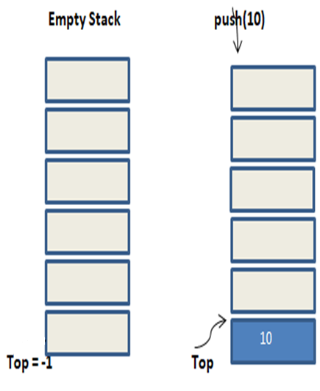
Push

Slide 8
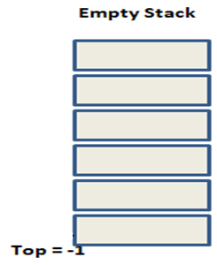

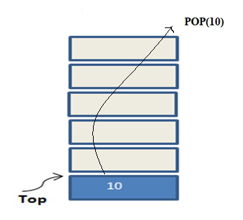
Pop

Slide 9
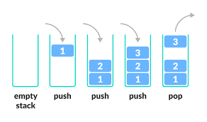

Slide 10
Array Implementation of Stacks
The array implementation of stacks involves allocation of fixed size array in the memory.
Both stack operations (push and pop) are made on this array with a constant check being made to ensure that the array does not go out of bounds.

Slide 13
Applications of Stack
•Checking of the parenthesis of an expression
• Reversing of a string
• Recursion
• Evaluation of Expression

Slide 14
Infix Notation
In infix notation, e.g. a - b + c, the operators are used in-between operands.
It is easy to read, write, and speak in infix notation but it does not go well with computing devices. An algorithm to process infix notation could be difficult and costly in terms of time and space consumption.
Prefix Notation
In this notation, operator is prefixed to operands, i.e. operator is written ahead of operands. For example, +ab. This is equivalent to its infix notation a + b. Prefix notation is also known as Polish Notation.
Postfix Notation
This notation style is known as Reversed Polish Notation. In this notation style, the operator is postfixed to the operands i.e., the operator is written after the operands. For example, ab+. This is equivalent to its infix notation a + b.

Slide 15
No. | Infix Notation | Prefix Notation | Postfix Notation
1 | a + b | + a b | a b +
2 | (a + b) ∗ c | ∗ + a b c | a b + c ∗
3 | a ∗ (b + c) | ∗ a + b c | a b c + ∗
4 | a / b + c / d | + / a b / c d | a b / c d / +
5 | (a + b) ∗ (c + d) | ∗ + a b + c d | a b + c d + ∗
6 | ((a + b) ∗ c) - d | - ∗ + a b c d | a b + c ∗ d -

Slide 16
Algorithm to evaluate the postfix expression
1. Create a stack to store operands.
2. Scan the given expression from left to right.
3. a) If the scanned character is an operand, push it into the stack.
b) If the scanned character is an operator, POP 2 operands from stack and perform operation and PUSH the result back to the stack.
4. Repeat step 3 till all the characters are scanned.
5. When the expression is ended, the number in the stack is the final result.

Slide 17
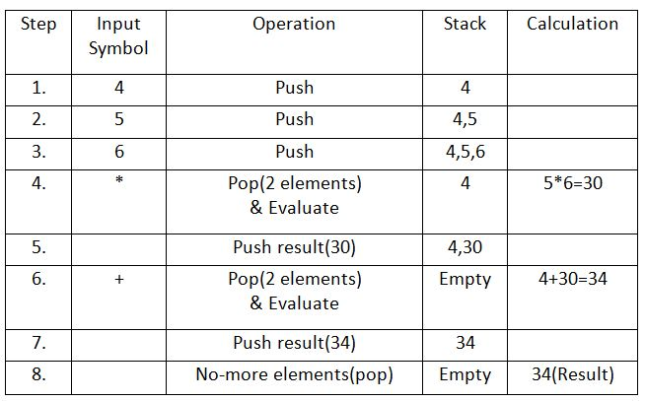
Example: 456*+

Slide 18
Algorithm to evaluate the prefix expression
1. Scan one char at a time from right to left in string.
2. If scan char is operand, push it in stack.
3. If scan char is operator, pop opnd1, opnd2 and perform the operation specified by the operator. Push the result into stack.
4. Repeat step 1, 2 and 3 until input prefix strings end.
5. Pop stack and display, which is required value of given expression.

Slide 19
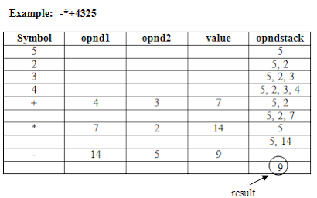

Slide 20
Queue
Queue is a linear data structure in which items are inserted at one end called ‘Rear’ and deleted from the other end called ‘Front’.
Queues are based on the First-In-First-Out (FIFO) principle that means the data item that is inserted first in the queue is also the first one to be removed from the queue.
During the INSERT operation we have to check the condition for OVERFLOW and during the DELETE operation we have to check the condition for UNDERFLOW.

Slide 21
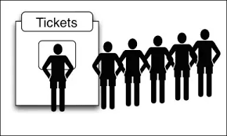
Queue in real Life

Slide 22
UNDERFLOW
The situation of trying to delete an element from an empty QUEUE.
Condition for UNDERFLOW
Front = -1 (for the QUEUE starts with 0)
CONDITION FOR EMPTY QUEUE
Front = -1 and Rear = -1 [for the QUEUE starts with 0]
OVERFLOW
The situation of trying to add an element to full QUEUE.
Condition for OVERFLOW
Rear = size -1 (for the QUEUE starts with 0)

Slide 23
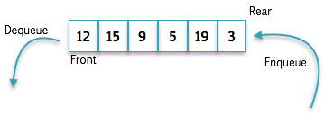
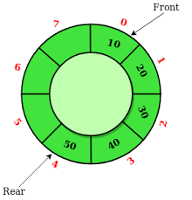
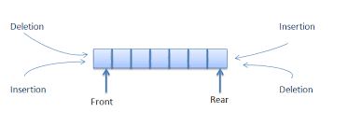
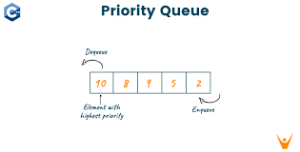
Types of Queue
• Linear Queue
• Circular Queue
• D - Queue (Double-ended queue)
• Priority Queue.

Slide 24
Logical Representation of Queues
Queues appear as a group of elements stored at contiguous locations in memory.
The array implementation of queues involves allocation of fixed size array in the memory. Both queue operations (insert and delete) are performed on this array with a constant check being made to ensure that the array does not go out of bounds.
Each successive insert operation adds an element at the rear end of the queue while each delete operation removes an element from the front end of the queue. The location of the front and rear ends are marked by two distinct pointers (variables) called front and rear.

Slide 25
Queue Operations
There are two operations associated with the queue data structure: insert (Enqueue) and delete (Dequeue). The insert operation adds an element at the rear end of the queue while the delete operation removes an element from the front end of the queue.

